Slide 1
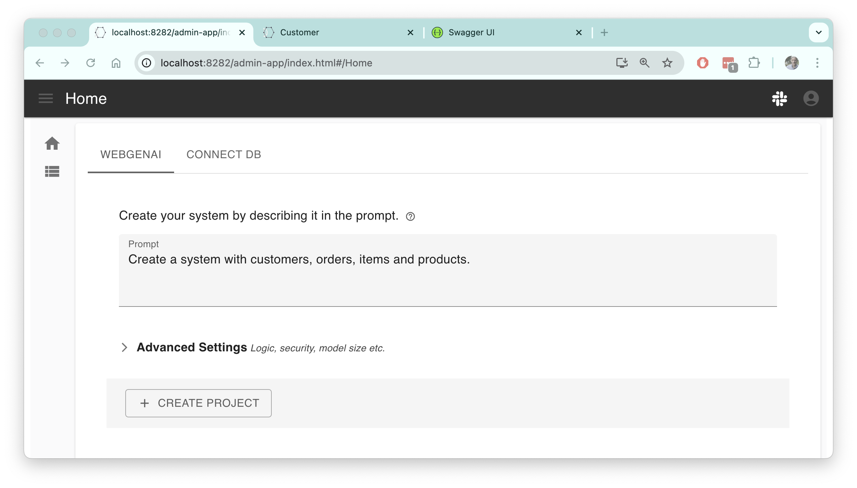




Database
API
App
API
Logic
Running
Notes:
Getting things right requires iteration. And we all know that running screens engage users far more than documents or wire frames.
Framework complexity leads to this unpleasant situation: months of effort to get some running screens, only then to uncover a misunderstanding. Low code can help, but it still takes time to design databases and paint screens.
The marriage of GenAI technology with Logic Automation means you can now describe a system with a prompt (as shown).
And get a complete running system — a database with test data, working screens, and an API. Even a fun little Landing Page (next slide).

Slide 2
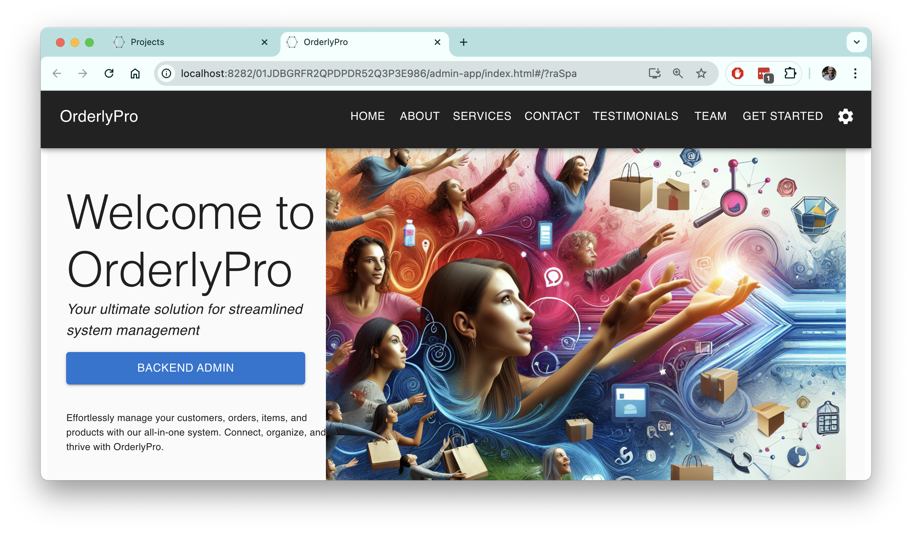
Created from prompt by GenAI
Admin App
Notes:
GenAI creates this fun Landing Page, from the prompt.

Slide 3
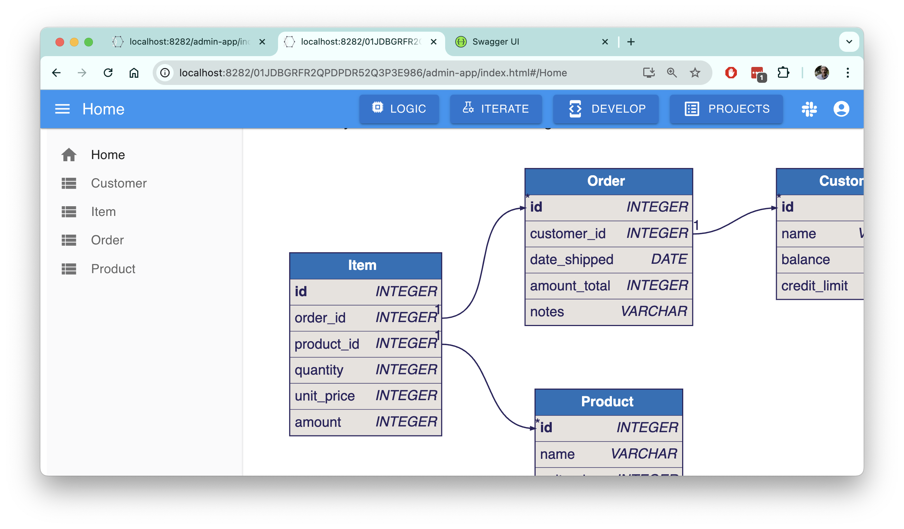
Admin App
Browse / Update your Data
Logic and Security Enforced
By Underlying API
Created by
GenAI/Logic Automation
(API Logic Server)
Notes:
Use the automatically created Admin App to Browse and Update your data. It is a complement to custom apps you can create using the API with tools such as AI/Dev, Low Code, or traditional frameworks.

Slide 4
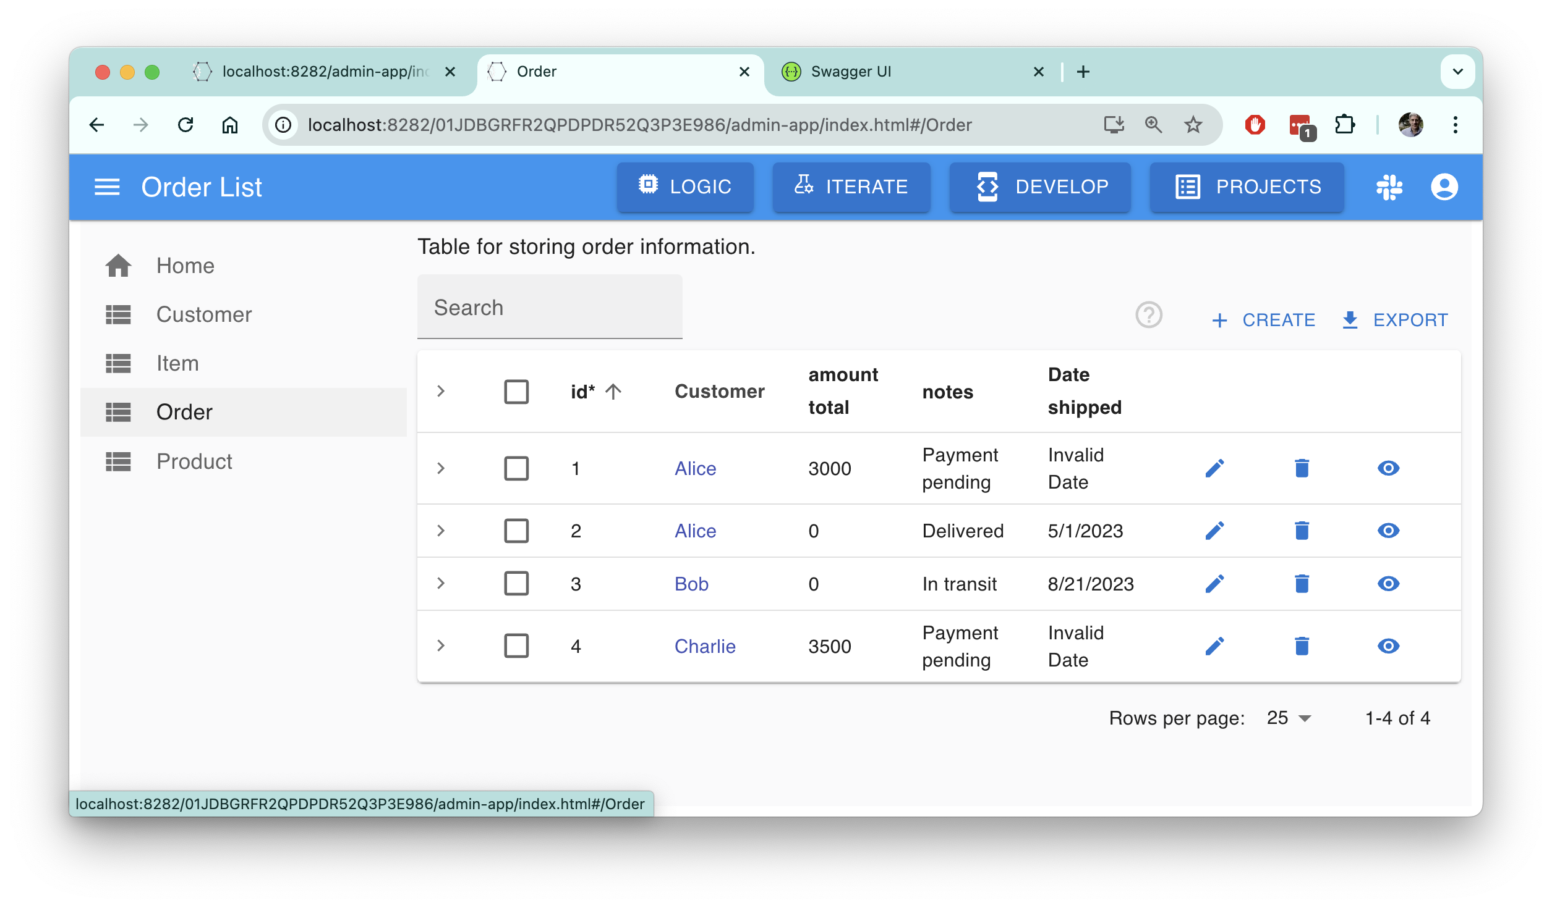
Admin App created by
GenAI/Logic Automation
Filtering, Sorting,
Multi-table, Multi-page,
Page Transitions

Slide 5
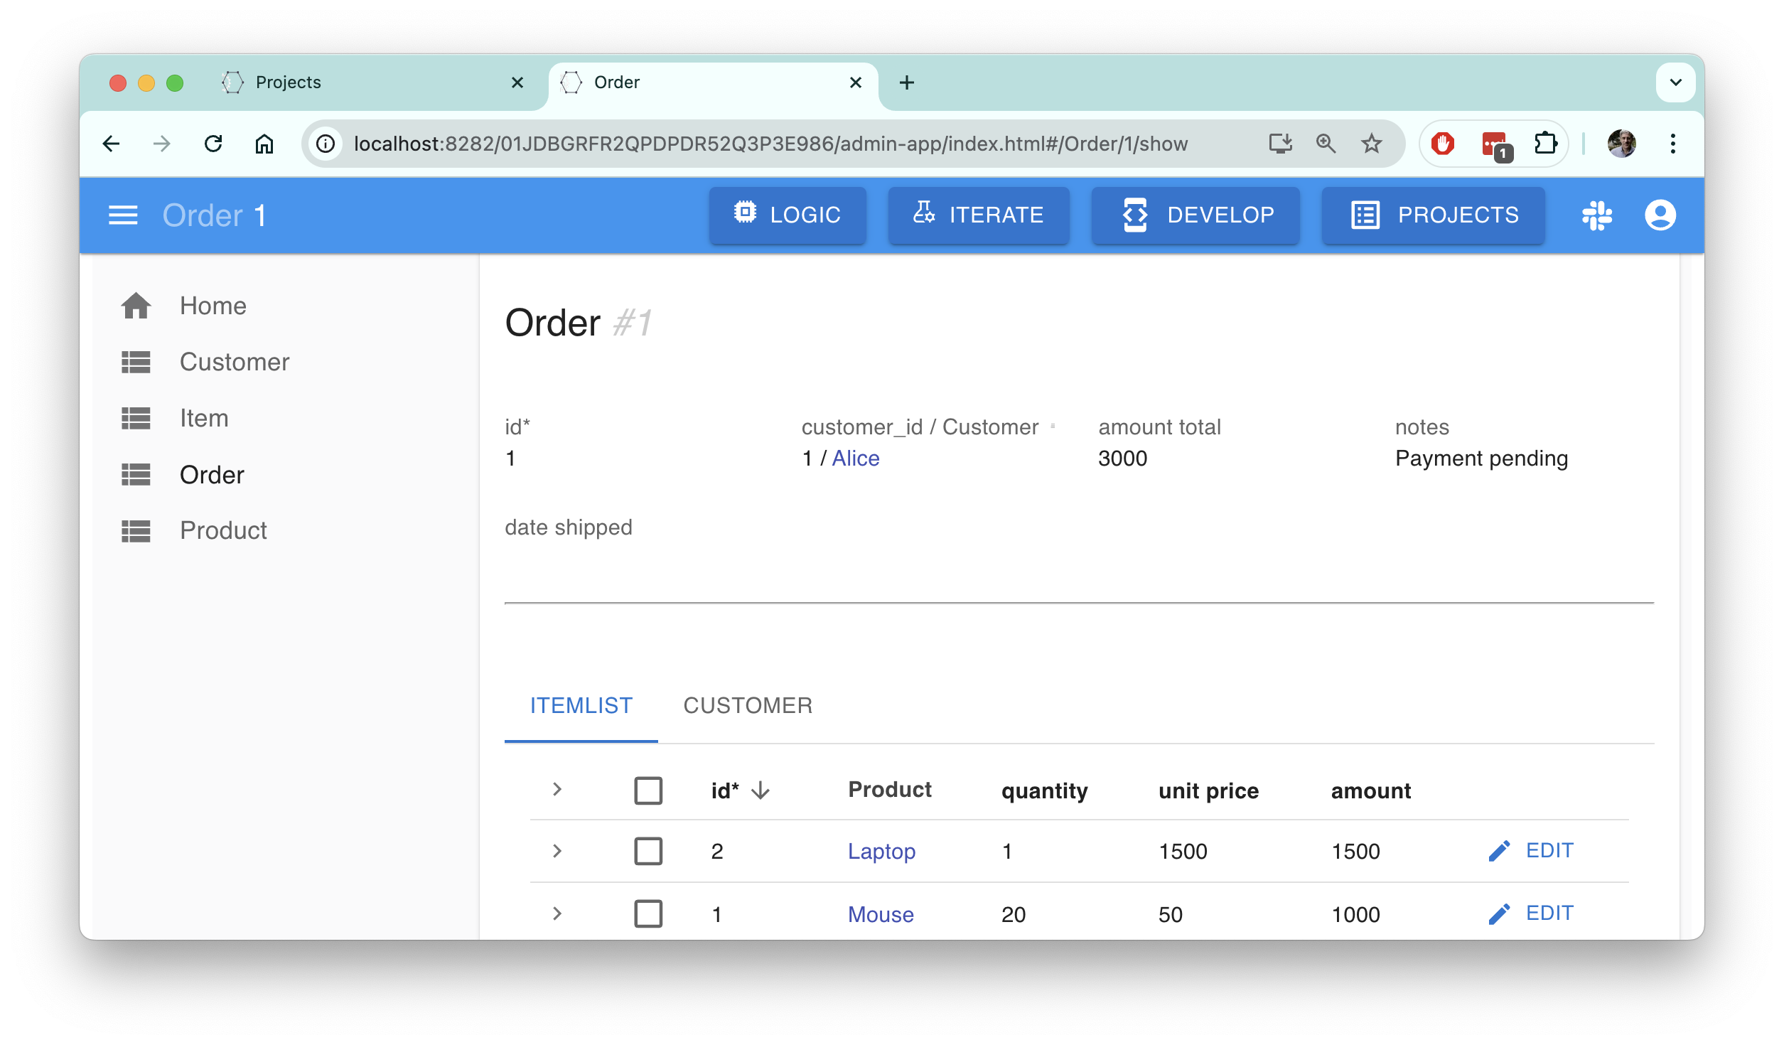
Admin App created by
GenAI/Logic Automation
Automatic Joins
(Product Name,
Not Number)

Slide 6
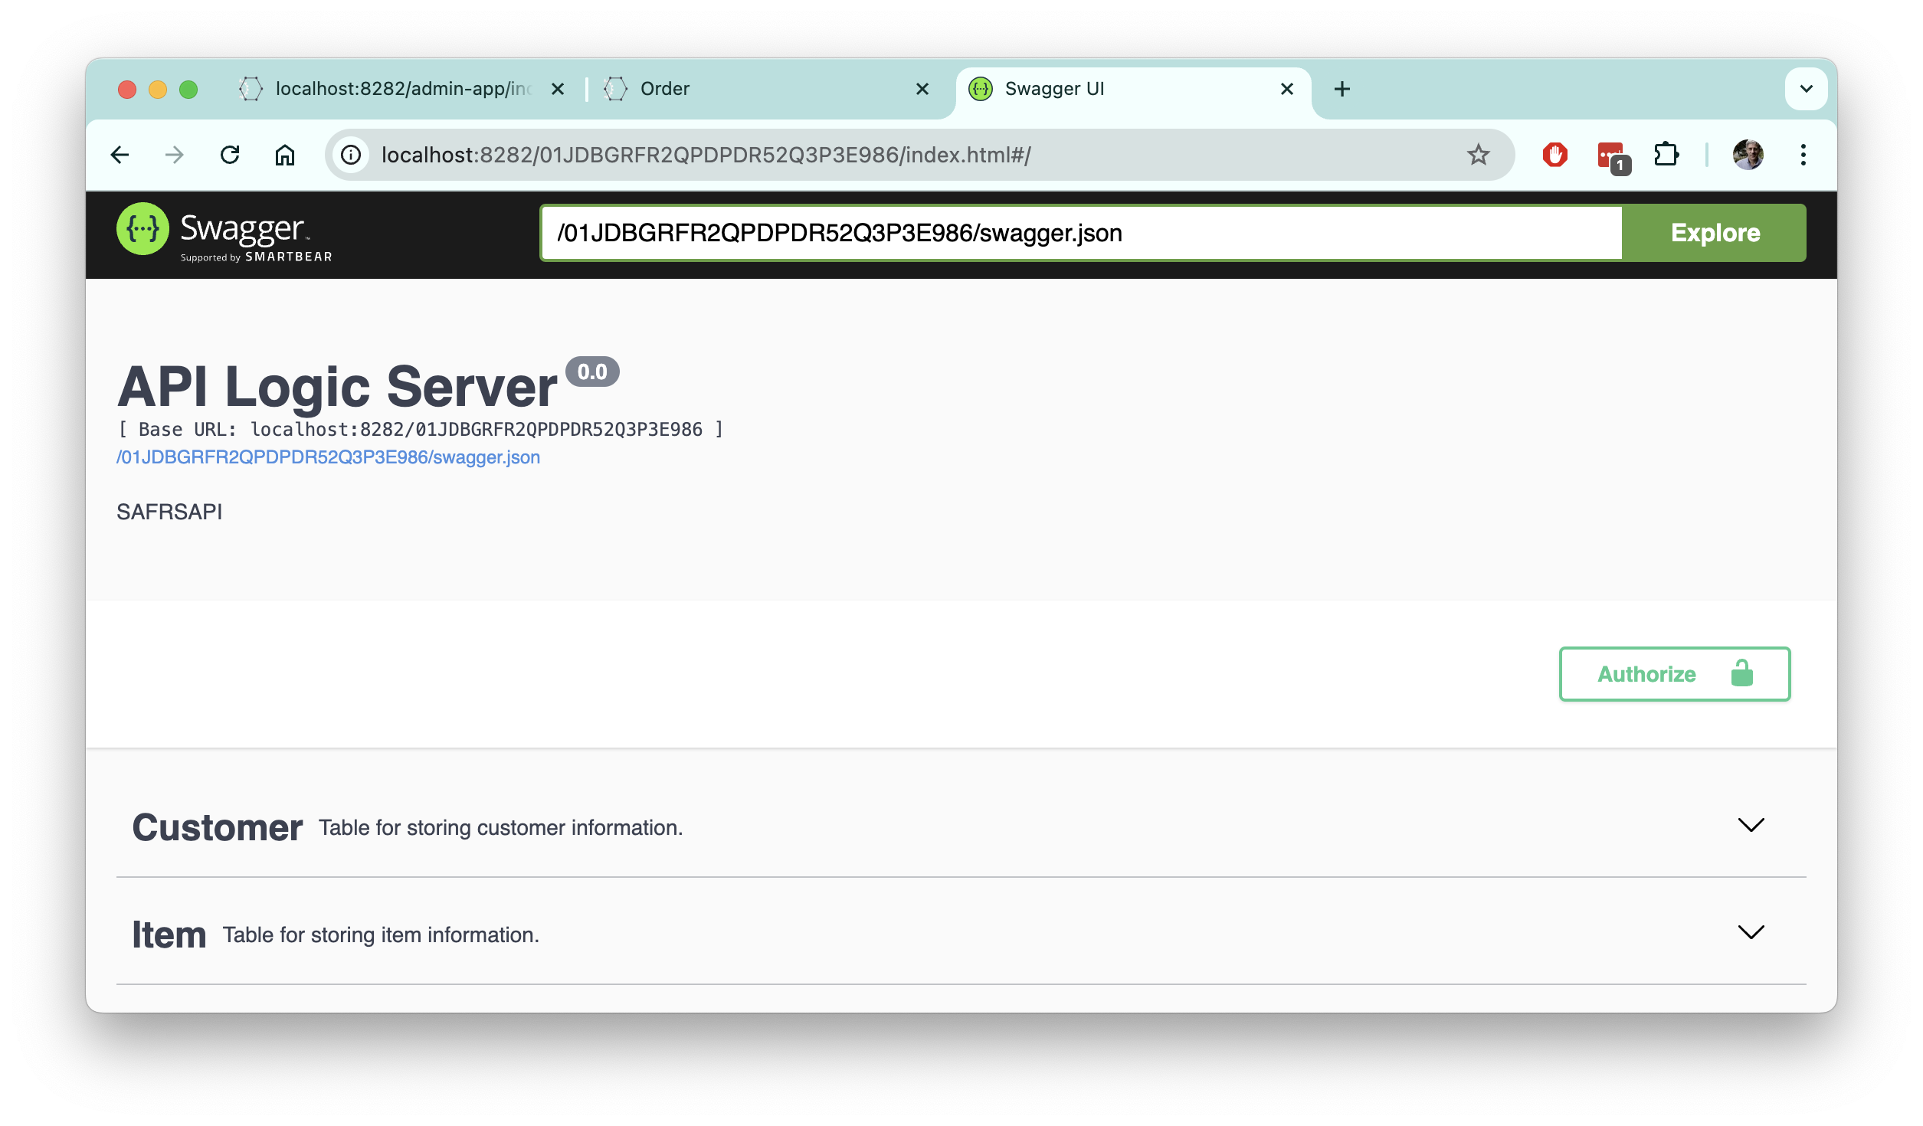
Automatic JSON:API
Filtering, Sorting, Pagination,
Optimistic Locking
Enforces Logic and Security
Logic: Multi-Row Derivations and Constraints
Security: Oauth2 Authentication,
Role-Based Row Access
Notes:
Your automated API is available, with OpenAPI (aka Swagger) to:
UI Developers can use it with AI-Dev tools, Low Code Tools, or traditional frameworks.
The logic has already been factored out and shared, so they can focus on presentation.
No more business logic in buttons — that’s a bug since it prevents sharing logic between apps, and with services.
App Integration can use it to read and write data, subject to security. Since the JSON:API enables callers to select and join exactly what they need, custom API dev is dramatically reduced.

Slide 7
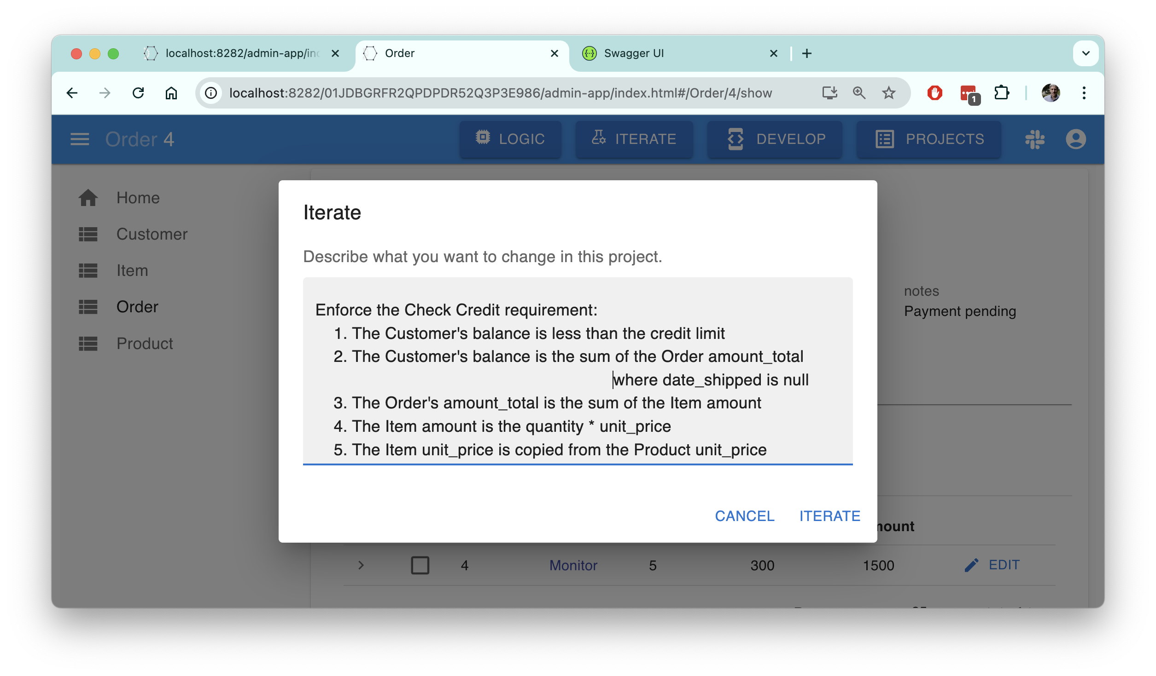

Multi-Table
Derivations and Constraints
Declare Logic
Natural Language
5 Rules
(not 200 lines of code)
Notes:
Now our team can review the screens, and identify changes. These might be structural (“customers have multiple addresses”), or logic (“it needs to check the credit limit”).
Here, we define “check credit” in Natural Language, and iterate.
And now that’s running, also in about a minute. Suddenly, iteration cycles that used to take months are happening in minutes. The time wasted in misunderstandings — they still happen, of course — is inconsequential. This helps us get the requirements right.
We are moving very rapidly, in the right direction.
The logic above, while stated in Natural Language, is immensely powerful. It’s automatically ordered (simplifying iterations), and is automatically reused over all the relevant Use Cases. So, perhaps conceived for placing an order, our logic also understands how to process selecting a different product (next slide).

Slide 8
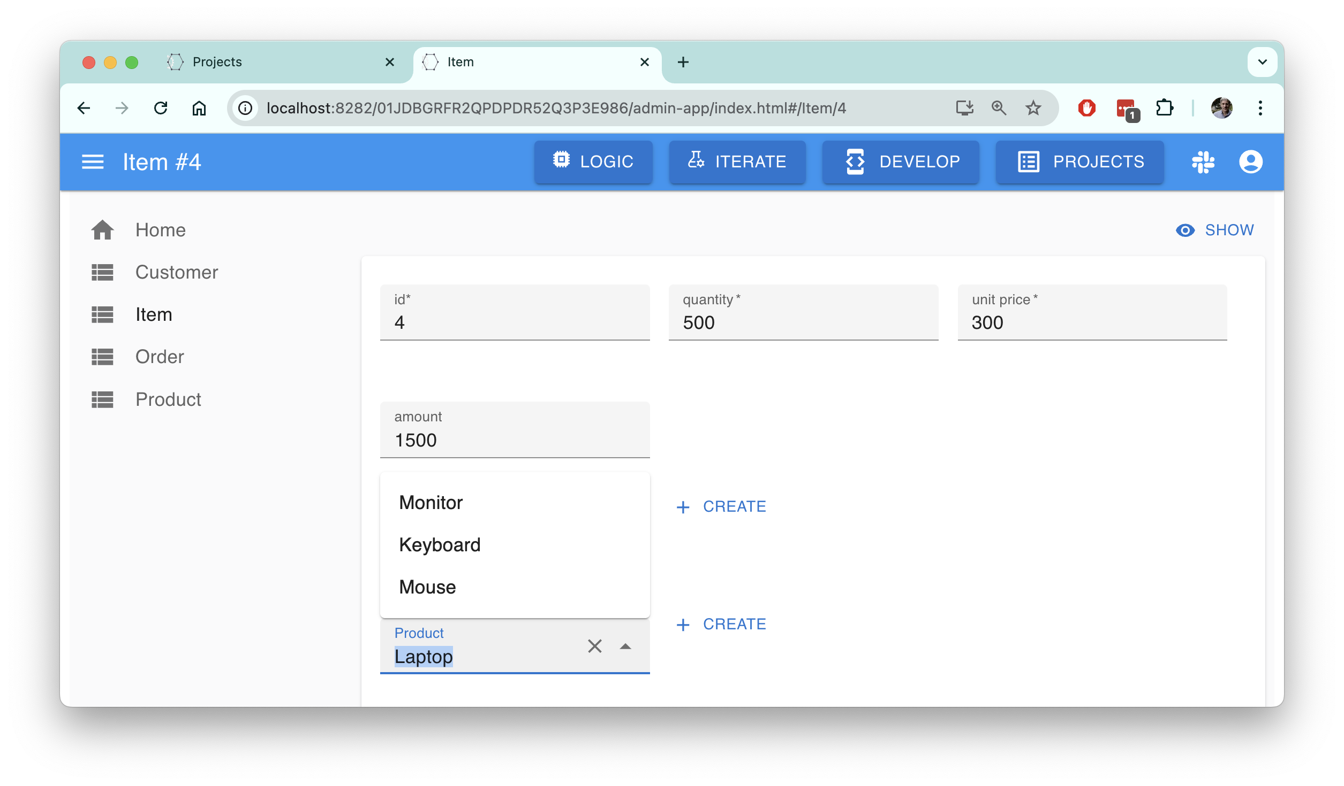
Admin App
Lookup to select
Different Product)
Notes:
We select a different Product; it costs more, so we cannot afford it.
Does our

Slide 9
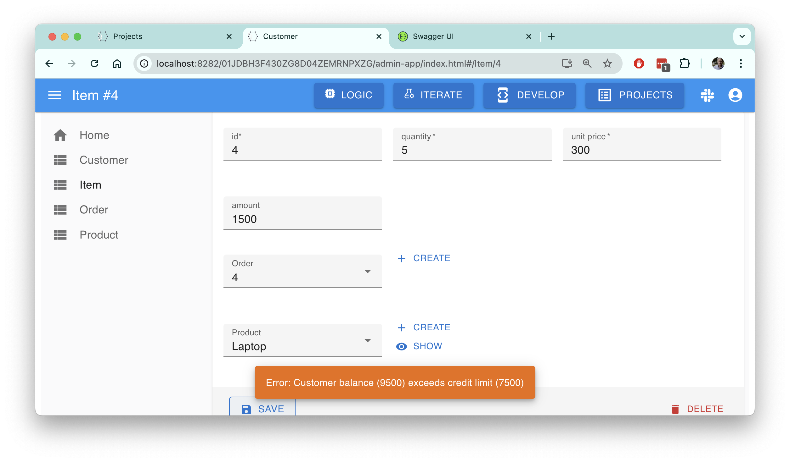
Admin App
4 Table Transaction,
Automated By
API / Logic
Notes:
Yes, the constraint fires, as it should.
The 5 lines of logic above applies to about a dozen Use Cases. Without logic automation, this would be about 200 lines of code.
That’s a 40X reduction, for the backend half of your system
So, we’ve applied automation to all the elements of our architecture: the database, the screens, the API, and the logic.
Simplicity enables your organization
The simplicity of GenAI — it’s just Natural Language — means we’re no longer limited to rocket scientists. Anyone can help get the requirements right.
Organizational velocity: more people, moving faster, in the right direction.

Slide 10
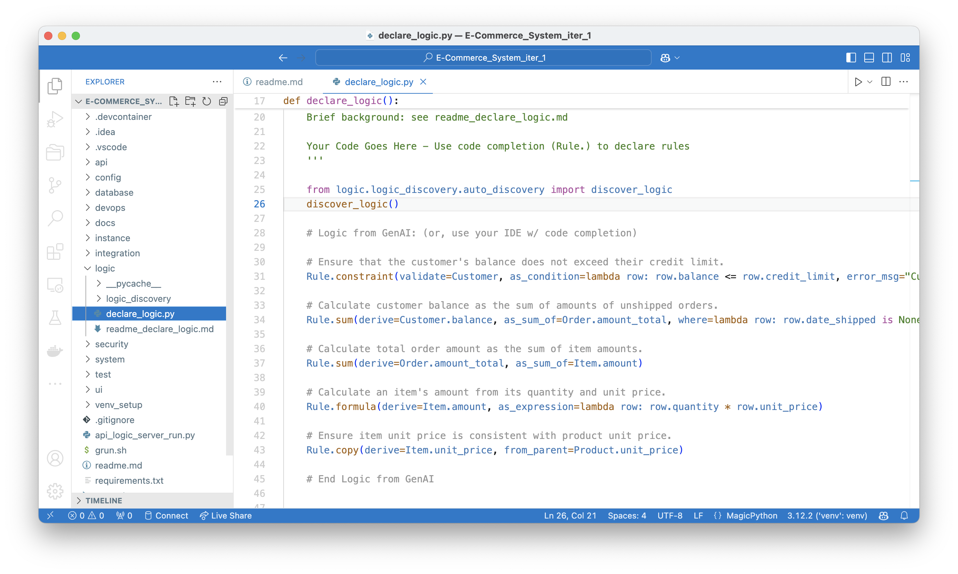
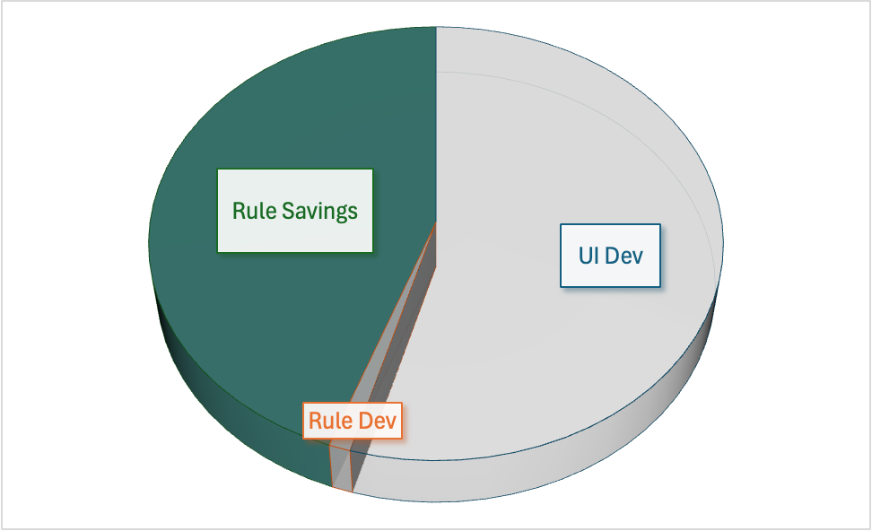
Logic – Multi-table
Derivations and Constraints
Backend Half of System
40X More Concise
Not FrankenCode
Nat Lang → Rule.
LogicBank executes
Similar Support
For Row Based
Access Control
Notes:
And here is the logic - 5 Python statements. It’s still at the same high level of abstraction, but you can now use code editors, debuggers and source control:
Note the automation process did not just generate “raw” Python code. It would be around 200 lines. And we tried it: basic GenAI creates code that is poorly optimized, and wrong (e.g., it missed the “reselect Product” corner case above). FrankenCode, at it’s worst.
The ideal approach marries GenAI with Logic Automation for UI, APIs and Logic… just like it does for SQL.

Slide 11
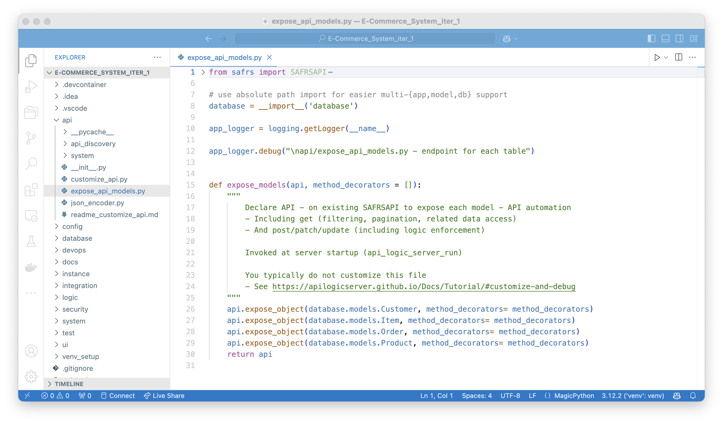
Project Created by
GenAI/Logic Automation
Model Driven
API is 4 lines of code
Simple and Clear
Not FrankenCode
Notes:
We are not claiming, by any means, that GenAI can automate complete Enterprise-class systems. You will want custom front ends, integration with business partners and internal systems, etc. This means developers absolutely need to get involved.
With… what? All we’ve provided is a few prompts…
As you might have expected, a project has been created. It’s a standard Python project you can download and extend in your favorite IDE, completely configured and ready to run.
Developers are cautious about generated “Franken-code”, for good reason. It can be monstrously difficult to understand, debug and extend.
So, GenAI-Logic creates models, not code.
The API is shown above.

Slide 12
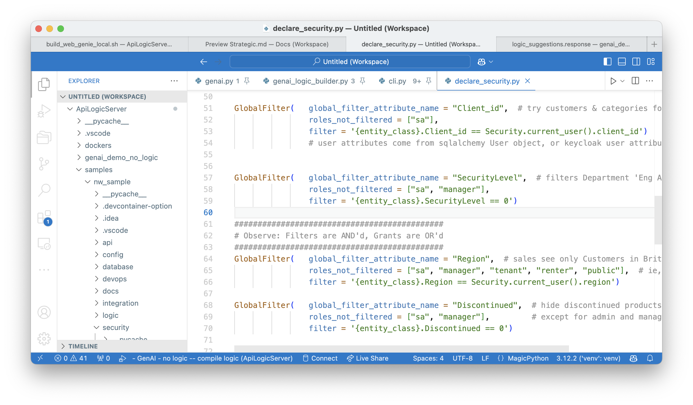
Declare Security
Authenticate (e.g., Keycloak)
Authorize (Role Based Access Control to Rows)
Notes:
Declarative support includes Security:
Authentication: use a database table, or Keycloak – Single SignOn, open authenticator (gmail, LDAP, AD, etc)
Authorization: configure roles with row level filters (eg, discontinued products, multi-tenant).

Slide 13
GenAI-Logic Creates Executable Models
Created Project
Models
(+ code as required)
Runtime Libs
Execution
Engines
App
safrs/ra
Customers
Orders
Products
Items
GenAI-Logic
API
safrs
Database
SQLAlchemy
Rules
LogicBank
Notes:
Project Creation results in models, not code.
The models are executed by corresponding runtime engines.
Provide standard Python code (e.g., events) as required.

Slide 14
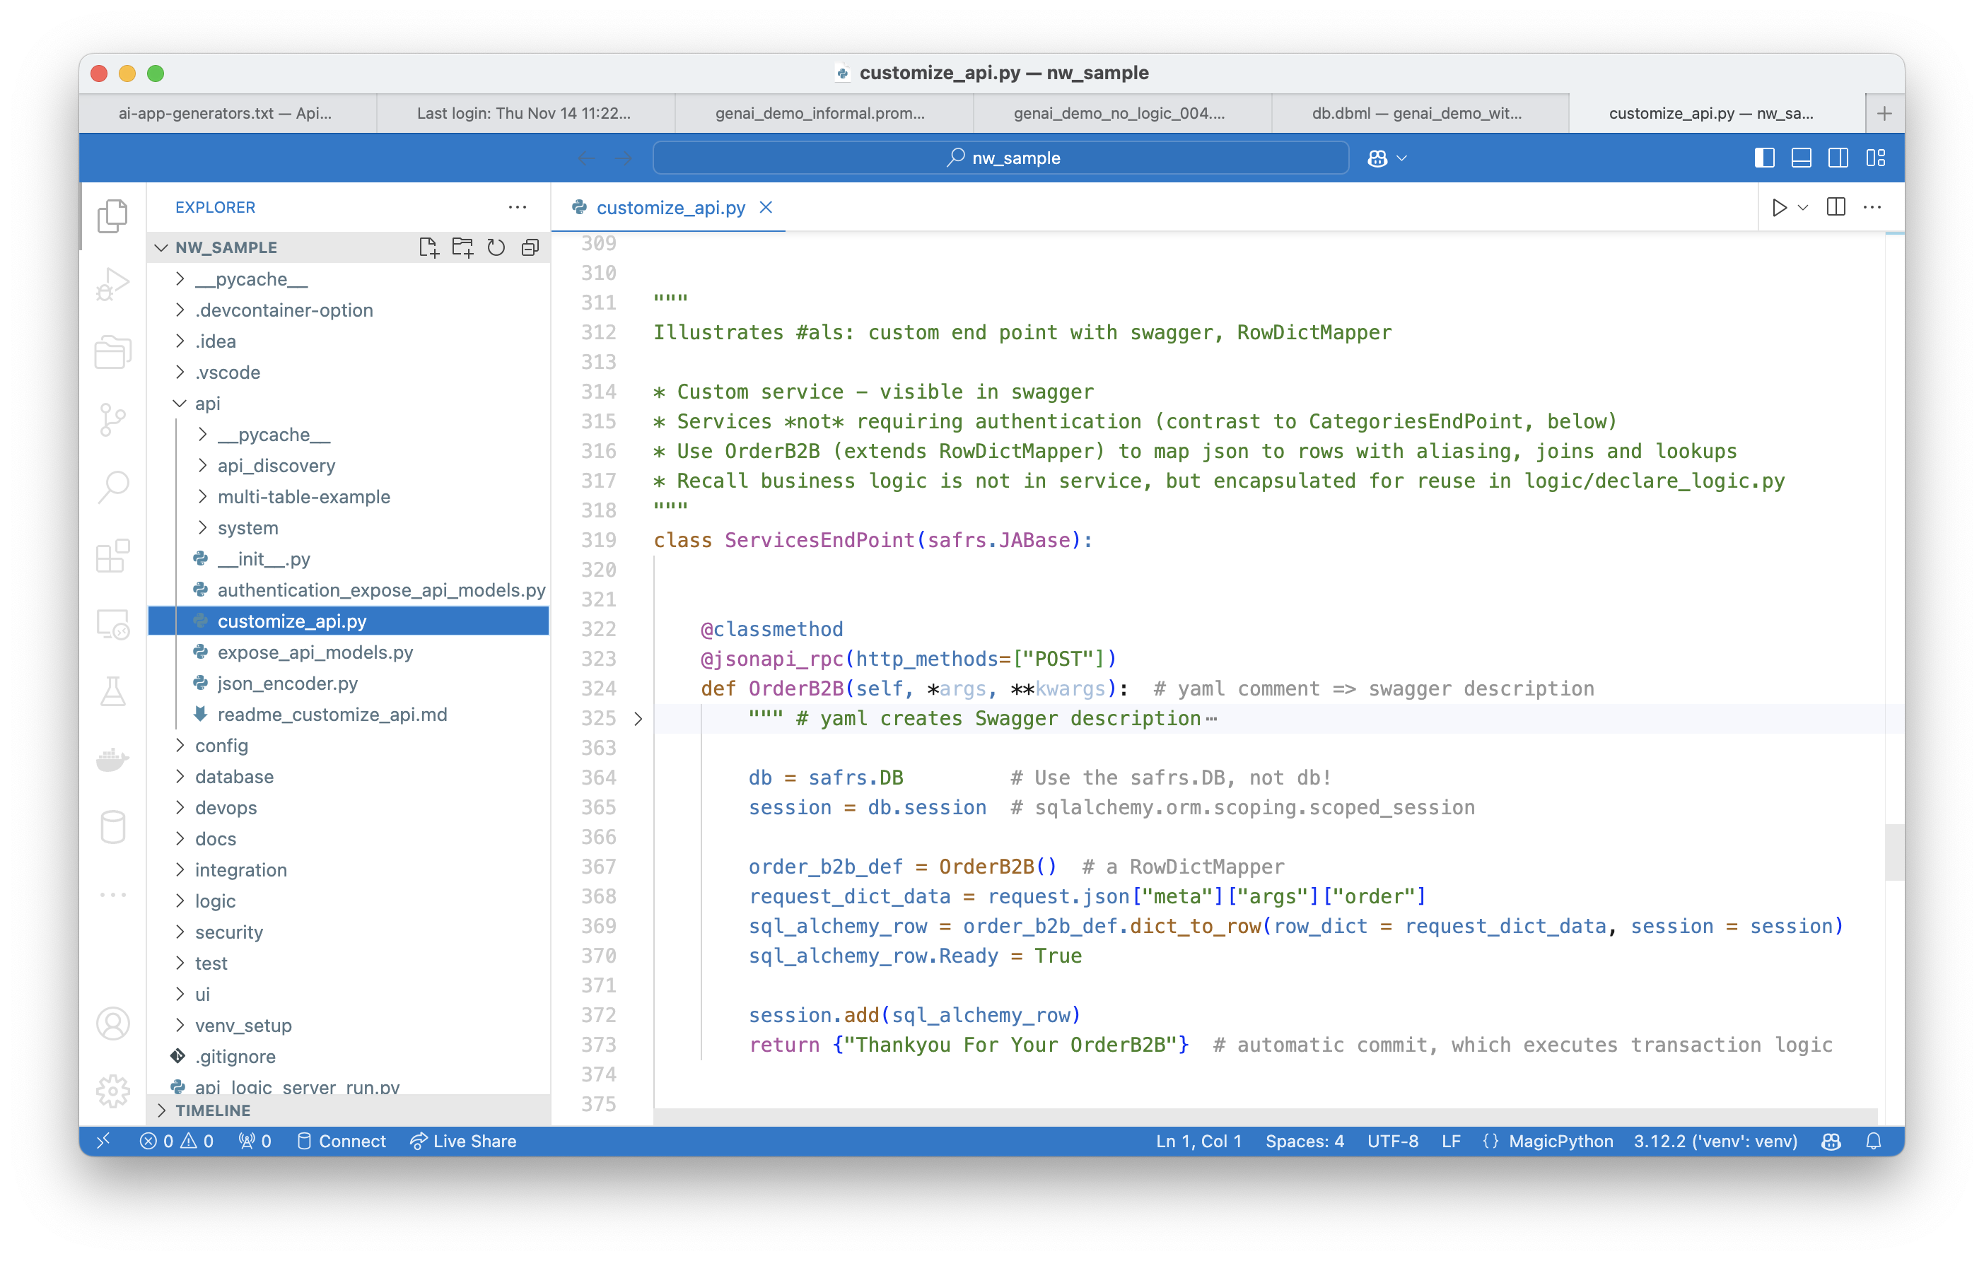
Custom API
Minimal Code,
since API enforces logic (via SQLAlchemy events)
Notes:
And, you have access to all the underlying standard tools (your IDE, GitHub etc) and frameworks. You can add custom endpoints, e.g., APIs for B2B partners, as shown here.

Slide 15
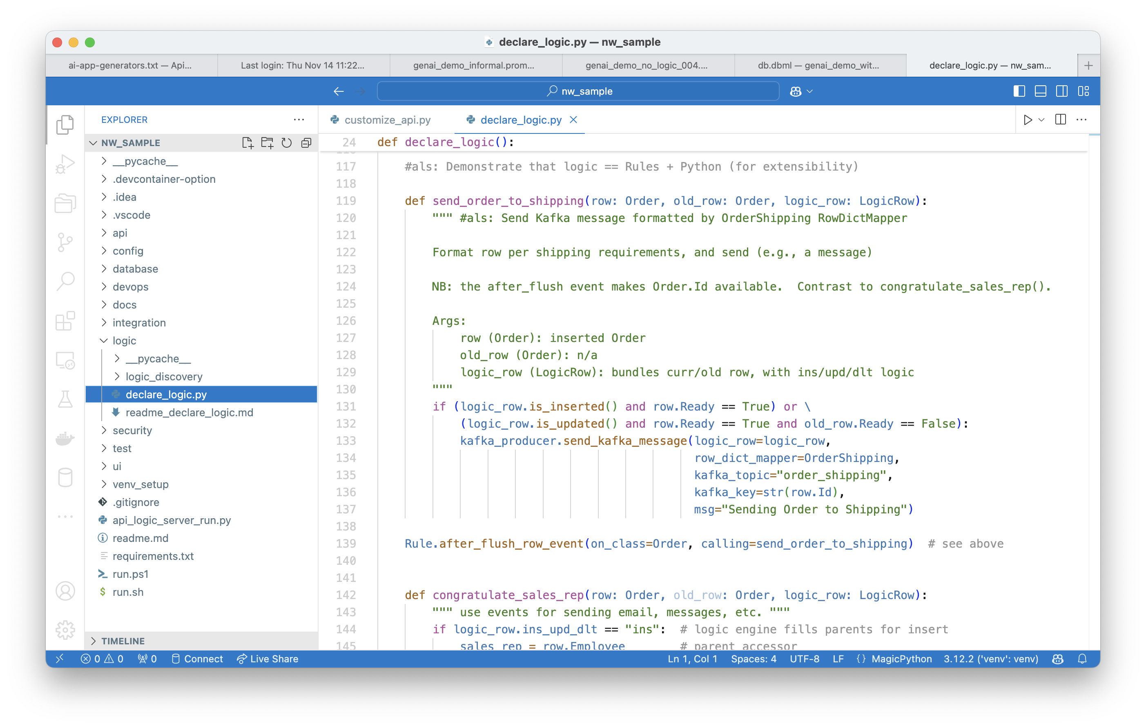
App Integration
Extend Logic with Kafka Integration
Notes:
Add logic to send messages, as shown here.
Organizational Velocity, Enterprise scale

Slide 16
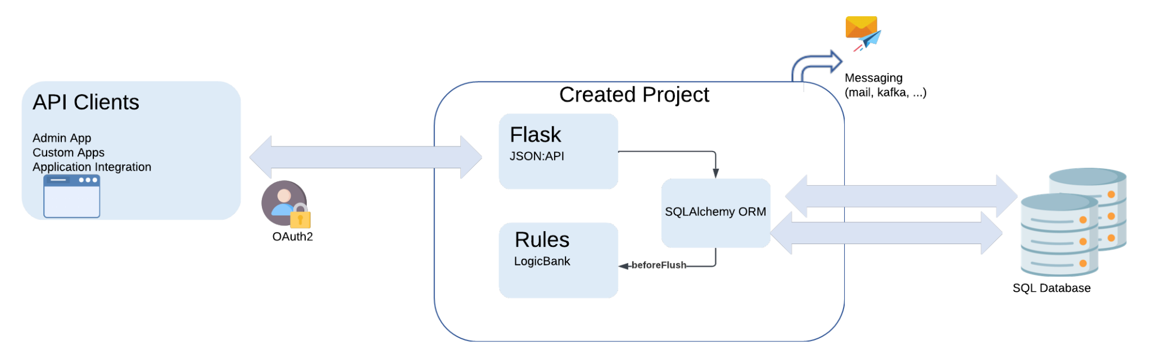
API Logic Server - Runtime Stack
API Encapsulates Rules
Notes:
Scripts are provided to containerize your app.
Containers are stateless, for scalability.
Deploy them anywhere. No fees apply.
LogicBank enforces your rules, by listening for beforeFlush events. It is not a Rete Engine – it is written to optimize transaction processing.

Slide 17
What | Why It Matters
1. Instant Working Software - GenAI | Enables Requirements Collaboration Rich API Unblocks Custom UI Dev
2. Iterate - Declarative Logic | Simple, Clear, and Transparent Concise: 5 Rules, or 200 lines of code
3. Open, Standard Customization | Models not code (eg, 5 rules) Your IDE, Python, libraries, tools…
4. Open, Standard Deployment | Deploy Anywhere, no fees
Notes:
The combination of GenAI and Logic Automation means Business Users and Developers can collaborate to create modern api-based systems, far faster and far easier than ever before. Including declarative business logic.
Use familiar tools for customization and deployment.
Integrate with partners and existing systems.

Slide 18

How did the screen review go?
Late.
Not what we meant.
Ouch.
Months, down the drain.

Slide 19
Idea
Running
Database
API
App
API
Logic

Slide 20

Kickstart: GenAI
- Idea to Run: 1 Minute
- Zero Training
- DB, API, Default App
App Model Editor
- Types, Masks, ??
Templates
- Card, Tree…
- Extensible
Solid API/Logic Server Architecture
Solid Requirements
UX
No ceiling
Standard Onimize components

